Slide 1
Software Prototyping
Animating and demonstrating system requirements

Slide 2
Lesson Objectives
To describe the use of prototypes in requirements validation
To discuss evolutionary and throw-away prototyping
To introduce rapid prototyping techniques
To explain the need for user interface prototyping

Slide 3
Topics covered
Prototyping in the software process
Prototyping techniques
User interface prototyping

Slide 4
Uses of system prototypes
The principal use is to help customers and developers understand the requirements for the system
The prototype may be used for user training before a final system is delivered
The prototype may be used for back-to-back testing, Reduces the need for tedious manual testing

Slide 5
Prototyping benefits
Misunderstandings between software users and developers are exposed
Missing services may be detected
Confusing services may be identified
A working system is available early in the process
The prototype may serve as a basis for deriving and refining a system specification

Slide 6
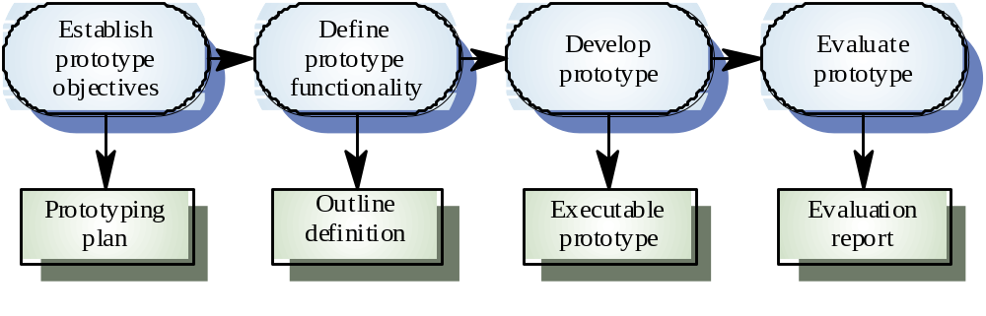
Prototyping process
Users interface
Validate Fun. Sys. Req.
Show Feasibility to management
May relax error handling
and standards of reliability
plus quality
What to include in proto
and what to leave out
tools, standards, relax non-functional req.
User can train
and become familiar
with new system

Slide 7
Prototyping objectives
The objective of evolutionary prototyping is to deliver a working system to end-users. The development starts with those requirements which are best understood.
The objective of throw-away prototyping is to validate or derive the system requirements. The prototyping process starts with those requirements which are poorly understood

Slide 8
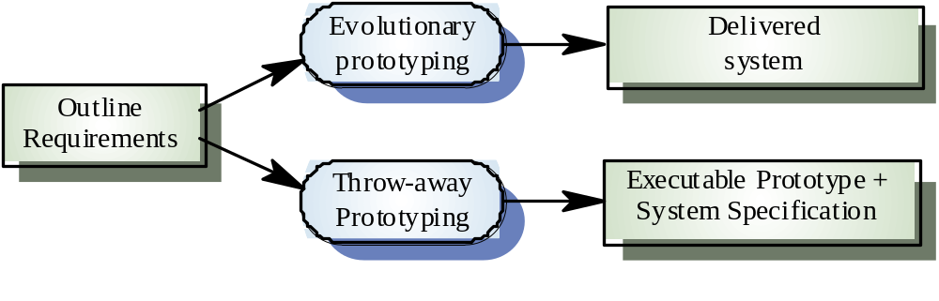
Approaches to prototyping
The objective of evolutionary prototyping is to deliver a working system to end-users
The objective of throw-away prototyping is to validate or derive the system requirements

Slide 9
Evolutionary prototyping
Must be used for systems where the specification cannot be developed in advance e.g. Artificial Intelligence systems and user interface systems
Based on techniques which allow rapid system iterations like the Spiral Model
Verification is impossible as there is no specification. Validation means demonstrating the adequacy of the system

Slide 10
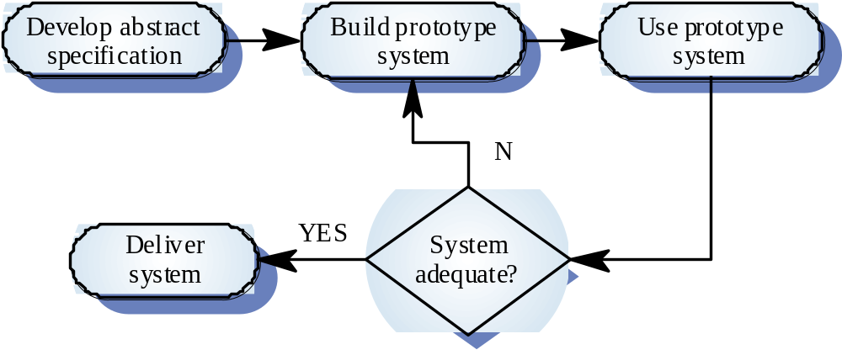
Evolutionary prototyping

Slide 11
Evolutionary prototyping problems
Existing management processes assume a waterfall model of development
Continual change tends to corrupt system structure so long-term maintenance is difficult & expensive
Specialist skills are required which may not be available in all development teams (Small teams of motivate people)
Organizations must accept that the lifetime of systems developed this way will inevitably be short

Slide 12
Throw-away prototyping
Used to reduce requirements risk
The prototype is developed from an initial specification, delivered for experiment then discarded
The throw-away prototype should NOT be considered as a final system
  Some system characteristics may have been left out
  There is no specification for long-term maintenance
  The system will be poorly structured and difficult to maintain

Slide 13
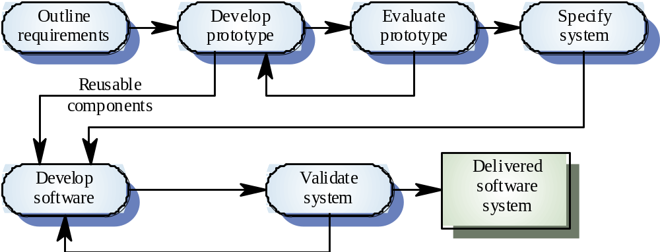
Throw-away prototyping
System Requirements Specification (SRS)
Developed for an online SRS, delivered for experiment and modification until the client is satisfied with functionality

Slide 14
Problems with System Specification Prototyping
Some parts of the requirements (e.g. safety-critical functions) may be impossible to prototype and so don’t appear in the specification
An implementation has no legal standing as a contract
Non-functional requirements cannot be adequately tested in a system prototype
Rather than derive a System Spec from a prototype some say a system Spec should be prototyped (write system like this)
The mode of use and training users is not available early enough
May have undesirable features like response time and the client will get negative feed back.

Slide 15
Incremental development an Alternative to evolutionary Prototyping
System is developed and delivered in increments after establishing an overall architecture
Users may experiment with delivered increments while others are being developed. Therefore, these serve as a form of prototype system
Intended to combine some of the advantages of prototyping but with a more manageable process and better system structure

Slide 16
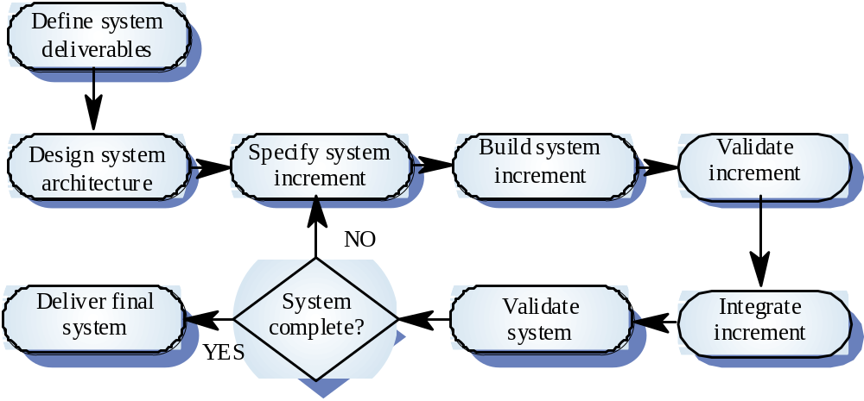
Incremental development process
1. More manageable than Evolutionary Prototyping
2. Plans & Documents produced/Updated at each stage
3. User feedback early
4. Limits system errors
5. Freeze interfaces therefore no need to retest
<= Advantages
Disadvantages =>
1. System Architecture has to be established before requirements are completed
2. The process may not fit well with the contract model

Slide 17
Prototyping techniques
Executable specification languages
Very high-level languages
Application generators and 4GLs
Composition of reusable components

Slide 18
Executable specification languages
The system is specified in a formal language
This specification is processed and an executable system is automatically generated
At the end of the process, the specification may serve as a basis for a re-implementation of the system

Slide 19
Problems with this approach
Graphical user interfaces cannot be prototyped
Formal specification development is not a rapid process, you must have experts in Formal Methods
The executable system is usually slow and inefficient
Executable specifications only allow functional requirements to be prototyped or tested
Non-Functional Requirements not included

Slide 20
Very high-level languages are Programming languages
Languages which include powerful data management facilities
Need a large run-time support system. Not normally used for large system development
Some languages offer excellent UI development facilities
Some languages have an integrated support environment whose facilities may be used in the prototype

Slide 21
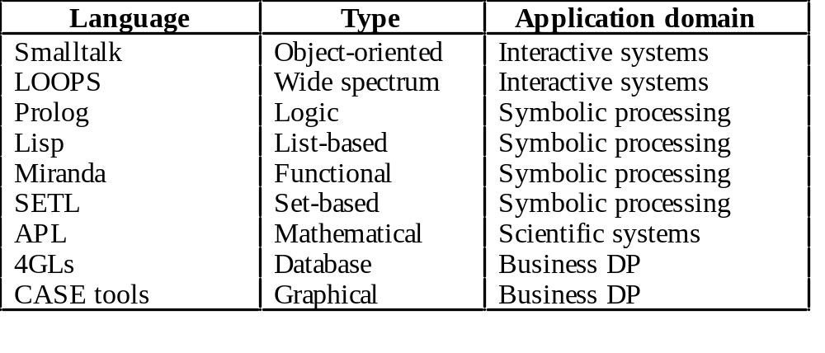
Prototyping languages

Slide 22
Smalltalk
Very powerful system for prototyping interactive systems
Object-oriented language so systems are resilient to change
The Smalltalk environment objects are available to the prototype developer
The system incldues support software such as graphical user interface generation tools

Slide 23
Fourth-generation languages
Domain specific languages for business systems based around a database management system
Normally include a database query language, a screen generator, a report generator and a spreadsheet
May be integrated with a CASE toolset
Cost-effective for small to medium sized business systems

Slide 24
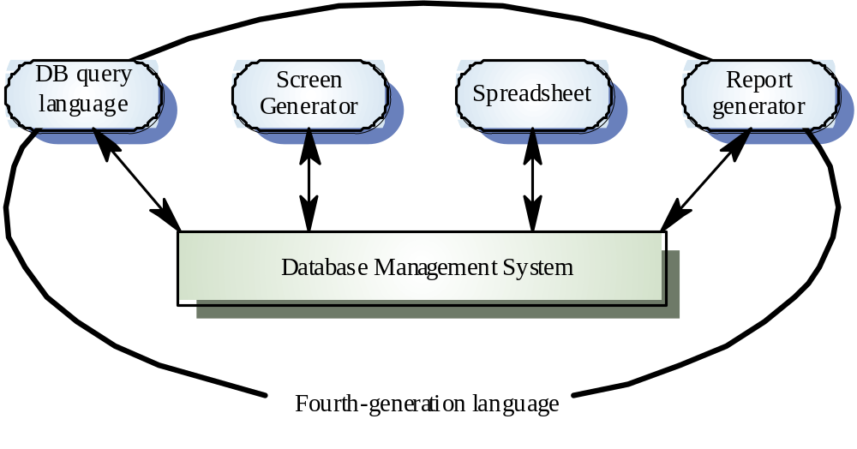
4GLs

Slide 25
Prototyping with reuse or reengineering
The system is prototyped by ‘gluing’ together existing components
Likely to become more widely used as libraries of objects become available
Needs a composition language such as a Unix shell language
Visual Basic is largely based on this approach
Java & Applets

Slide 26
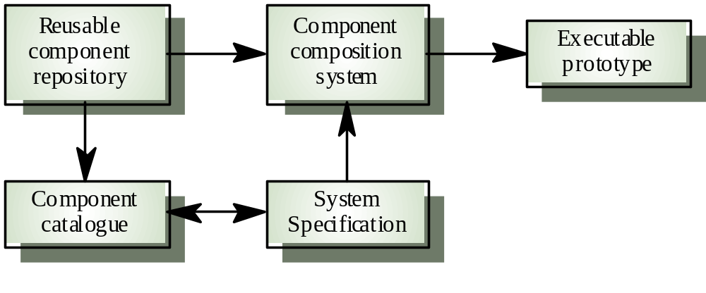
Reusable component composition

Slide 27
User interface prototyping
It is impossible to pre-specify the look and feel of a user interface in an effective way. prototyping is essential
UI development consumes an increasing part of overall system development costs
Prototyping may use very high level languages such as Smalltalk or Lisp
User interface generators may be used to ‘draw’ the interface and simulate its functionality

Slide 28
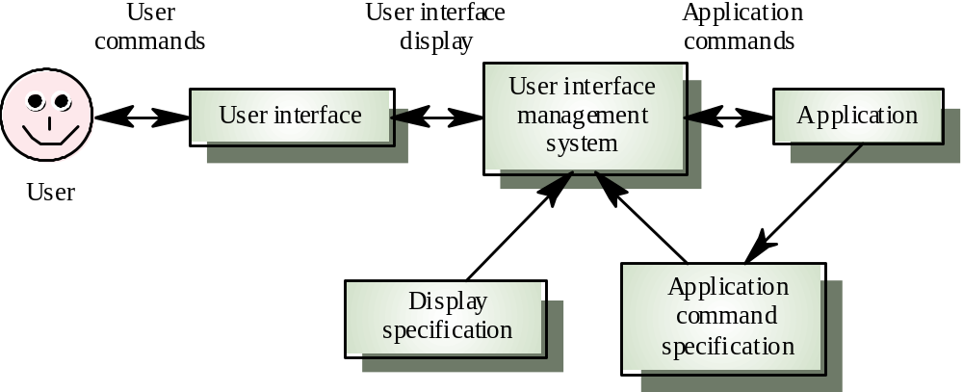
User interface management system

Slide 29
Key points
A prototype can be used to give end-users a concrete impression of the system’s capabilities
Prototyping may be evolutionary prototyping or throw-away prototyping
Rapid development is essential for prototype systems
Prototype structures become corrupted by constant change. Hence, long-term evolution is difficult

Slide 30
Key points
In a throw-away prototype start with the least well-understood parts; in an evolutionary prototype, start with the best understood parts
Prototyping methods include the use of executable specification languages, very high-level languages, fourth-generation languages and prototype construction from reusable components
Prototyping is essential for parts of the system such as the user interface which cannot be effectively pre-specified

